Slide 1
Year 3 Curriculum Sharing
Mr Witcomb and Mr Coates
Mr Witcomb (Monday-Wednesday)
Mr Coates (Thursday-Friday)

Slide 2
Year 3 and Key Stage 2
Moving into Key Stage 2, we will be focusing on independence and responsibility. This means the following:
Your child will be expected to take responsibility for his or her own belongings.
Children will be in charge of changing their reading book as well as handing in letters, homework and planners. They will also need to remember their swimming kit.

Slide 3
Literacy
Handwriting every morning.
Spelling or Guided Reading – every morning.
Daily Language and Literacy lessons.
‘Big Write’ every other week.
Discrete grammar sessions taught throughout each unit.
Reading practice and comprehension – during Guided Reading sessions and Literacy lessons.
Book bands from last year continue. Each child should have a banded book at home.

Slide 4
Maths
Taught daily.
Each lesson starts with a ‘Five a Day’ challenge, based on arithmetic skills.
‘Big Maths’ every other week, with a continued focus on solving word problems.
KS2 Calculation policy is on the school website.

Slide 5
Science
Unit 1 Plants
Unit 2 Animals Including Humans
Unit 3 Light
Unit 4 Rocks
Unit 5 Forces and Magnets
Unit 6 Scientists and Inventors

Slide 6
Topics (history and geography)
Rainforests
The UK
The Ancient Egyptians
The Stone Age
All Around The World
The Railways

Slide 7
French, PSHE & RE
French will be taught every Wednesday afternoon.
Formal and ad hoc PSHE sessions when needed.
Family and relationships, health and wellbeing.
Understanding feelings.
Zones of regulation.
What makes us human? Where do our morals come from? What happens when we do wrong?

Slide 8
PE and Games
Swimming every other Tuesday (alternating groups).
PE on Tuesday and Friday.
Gymnastics
Dance
Circuits
Hockey
Netball
Football
Rugby
Basketball
Tennis
Rounders
Cricket
Sports Day
Notes:
Children to wear PE kit every Tuesday and Friday… if in doubt.

Slide 9
Swimming
Year 3 swim every Tuesday at the school swimming pool.
Children will swim every other week.
Your child’s kit should include the following: costume, towel and swimming hat.
Check your emails for a swimming/PE timetable for this term.
There will be timetables going home.

Slide 10
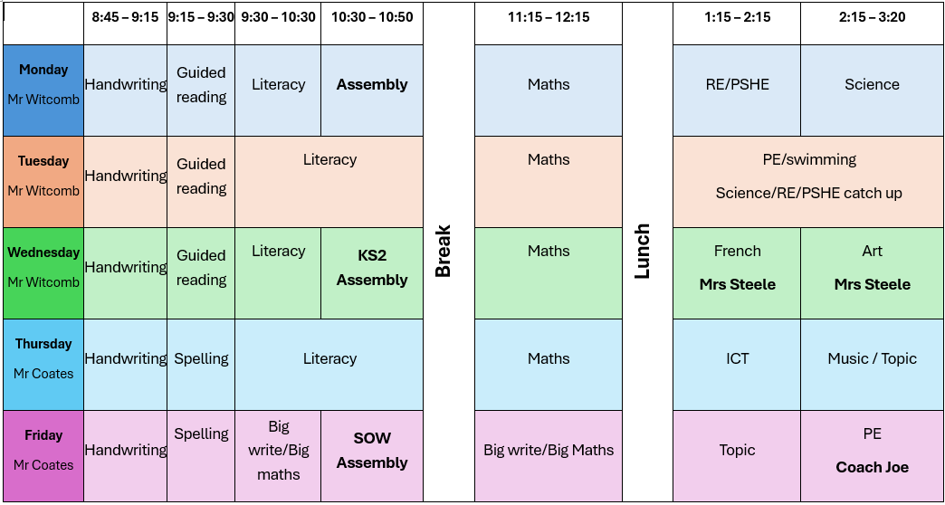
Timetable

Slide 11
Rewards and sanctions
Team points
Star of the week
Value bands – Truth, Politeness, Respect, Kindness and Doing Your Best.
Codes system:
Orange: 10 minutes of break time
Blue: whole of break

Slide 12
Homework
Given out every Thursday and collected in the following Thursday.
Spelling Shed and Times Table Rockstars homework each week – 10 minutes of TTRS and 10 Spelling Shed games. They can do more if they would like! Your child's log in is in their planner.
Each child is expected to read at least four times a week. It should be written up and signed off by parents in their planners.
There is also optional homework based on each term’s topic. Check your emails for this term’s selection of rainforest activities.

Slide 13
Maths Made Clear
Last year, the school made a series of films with the aim of helping parents to understand how we teach maths in the school.
Hopefully this will allow you to help your children to develop their maths skills at home.
Search for ‘Maths Made Clear’ on YouTube or click here for a playlist of our videos.

Slide 14
Library
The library will be open every Tuesday breaktime for children to borrow books.
Mrs. Legg has started to run sessions to teach children how to use the library and organise library cards for those who don’t already have one.
The bookshop is open every Wednesday breaktime, where children can buy books and stationery. They can even save up for a book they really want.
If you have overdue books, don’t worry! If your child brings their books back on a Tuesday, they won’t be charged.

Slide 15
Trips and visits
The Rabbi Visit – 18th November
Ancient Egypt Day – in January, a company called History off the Page visits the school for the day to offer the children an interactive experience. (14th January)
Stone Age-themed trip to Hill End, near Oxford (11th March -TBC).

Slide 16
Playtime
In Key Stage 2, there is no official playtime in the afternoon. However, we are aware that sometimes the children will need a break!
Children are no longer provided snacks by the school, so they must be brought in.
Snacks must be healthy – fruit and veg only.

Slide 17
Parent consultations
Exact dates are to be confirmed.
The first is usually on Tuesday and Thursday after school towards the end of Term 2.

Slide 18
Forest Camp
Year 3 groups will be going to Forest Camp on a Wednesday afternoon. Dates will be confirmed soon.
There will be at least one more opportunity for children to go to Forest Camp this year.

Slide 19
Questions
Do children come into school wearing PE kit on PE days?
Yes, children should come to school in their PE kit. Also, pack a change of clothes and shoes in case they get muddy or wet.
Can they bring football boots?
No football boots for PE lessons. After-school clubs may have different rules – check with the relevant staff.
Can they do anything on Spelling Shed or Times Tables Rockstars (TTRS)?
Yes, but they should focus on the assigned homework in the “assignment” section. Ask a team member if you need help locating it.
Can they do Spelling Shed themselves or do they need supervising?
Homework should be done independently, but support can be provided as needed. Speak with the year 3 team if you have any concerns.
Do we record spelling and Times Tables (TTRS) homework in their planners?
No need to record – teachers can track progress electronically. Speak to the Year 3 team if you have any concerns.

Slide 20
Questions
If we read with our child should we still record it in their planner?
Yes, please record all reading-it all counts.
Are there any lunchtime clubs that children can do and do we need to sign them up for these?
No need to sign up – children choose for themselves.
Choir: will open to Year 3 in the new year (Mrs Lowe and Mrs Murdoch will confirm dates)
Are there any sports clubs for Year 3?
Information coming soon – watch out for updates from JNR and the office.
- Run club: Every Wednesday morning, 8:00 – 8:30 am

