Slide 1






YEAR 1
CURRICULUM SHARING
2024-25

Slide 2




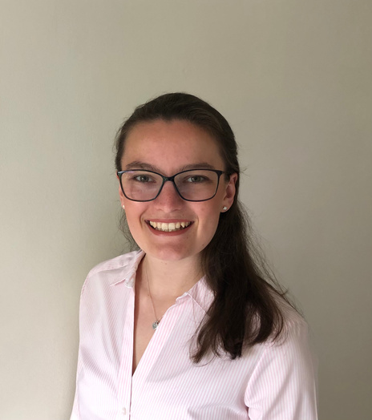
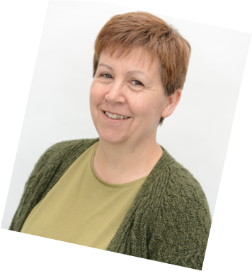
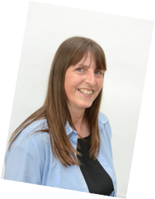
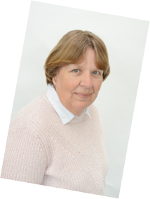
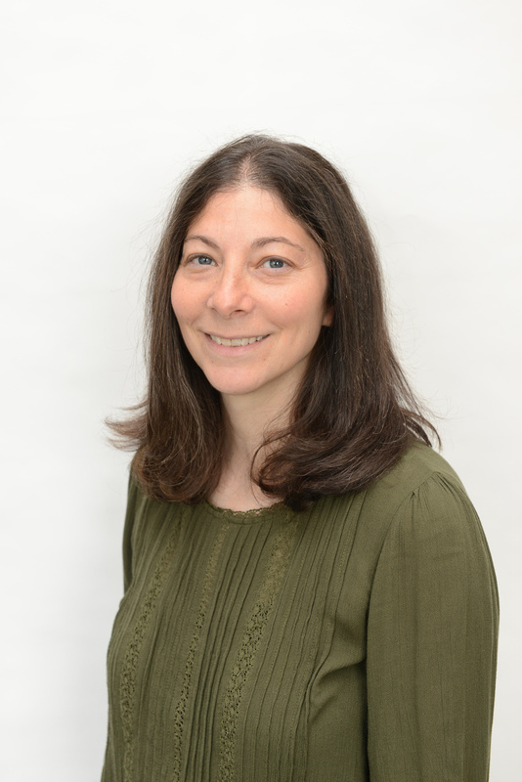
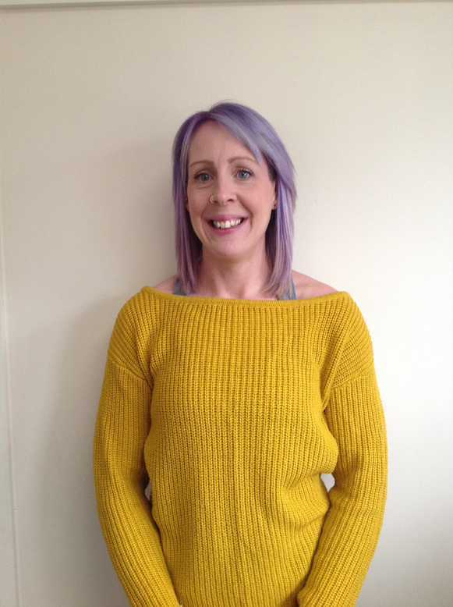

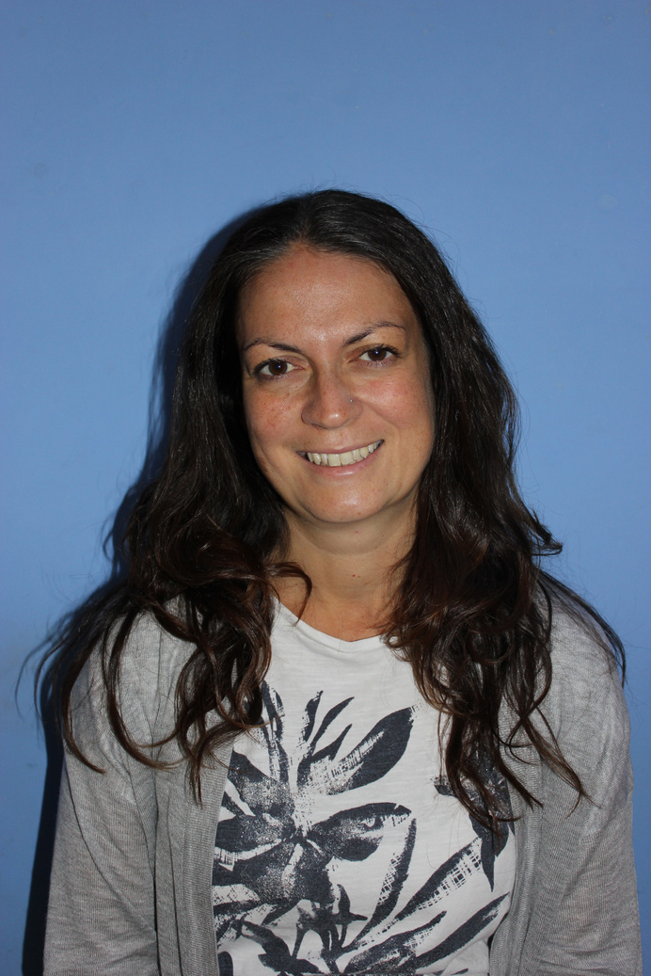
MEET THE TEAM
Miss Snowden
Miss Bartlett
Miss Chadwick
Mrs Meredith
Miss Handley
Miss Boyle
Mr Spencer
Mrs Bray

Slide 3



A TYPICAL DAY
Phonics
Handwriting
Assembly
Break time
Maths
Lunch time
Afternoons vary
Art RE
DT PSHCE
PE
Science

Slide 4


OUR TOPICS
The human body/healthy eating
Toys now and then
Materials and traditional tales
Seasons
Plants
Animals

Slide 5



COMPUTING
What we focus on:
  Logging in
  Files
  Internet safety
  Simple algorithms

Slide 6



SWIMMING AND PE
Swimming
When:
Thursday
every week
Unless we have told you otherwise
PE
When: Monday
Please come to school in PE kit.

Slide 7

FOREST CAMP
When
Monday or Tuesday
Please make sure named forest camp kit and wellies is in school.
What my child needs:
  Wellies
  Warm clothes
  Waterproof trousers
  Waterproof coat

Slide 8

THINGS TO REMEMBER
  Make sure your child is wearing the correct uniform
  Waterbottles in everyday
  Wellies and Shoes that fit, and the children can put on independently
  Show and tell: paper format, email in photos
  Please arrange an appointment with us to communicate after school, unless it is urgent
  Coats/hats appropriate for weather
  Fruit and vegetable snacks, and WATER not juice.

Slide 9
MATHS
We work on:
  Number recognition
  Counting (in 1s, 2s, 5s, 10s)
  Ordering numbers to 20 and 100
  Place value
  Odd and even numbers
  Recognising + - = x
  Simple sums
  Halves and quarters

Slide 10
LITERACY
  Our Literacy Scheme is called Read, Write Inc. which integrates, phonics, reading and writing
  All children are grouped according to their existing phonics knowledge
  Children are taught phonics skills, including reading and writing, everyday!
  http://www.ruthmiskin.com/en/resources/tag/parents/

Slide 11

READING
  Books are changed on Tuesdays and Fridays
  Books should be kept in book bags and sent in daily
  Children are sent home with a picture book and a reading book
Please read with your child and initial
times a week

Slide 12
A FEW THINGS
  Rewards
  Houses
  Behaviour and codes
  Assemblies
  PTA
  Things to do at home
  Things it’s helpful to tell us

Slide 13

Any questions?

