Slide 13

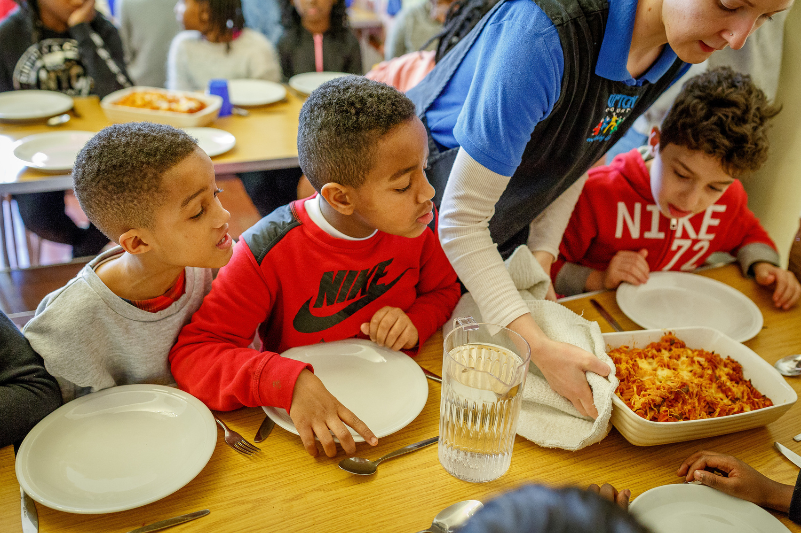

Food!
At Ufton, your child will enjoy three delicious, well-balanced meals each day, lovingly prepared by our catering team, plus two tasty snack breaks to keep them energised.
Meals are a time for everyone to come together in the dining room, creating a wonderful sense of community and shared experience.
We accommodate for dietary needs, with our menus carefully planned using the information provided on dietary forms ahead of the visit.
Your school must submit dietary requirements via an online form in advance to ensure catering accommodations can be made.

Slide 14

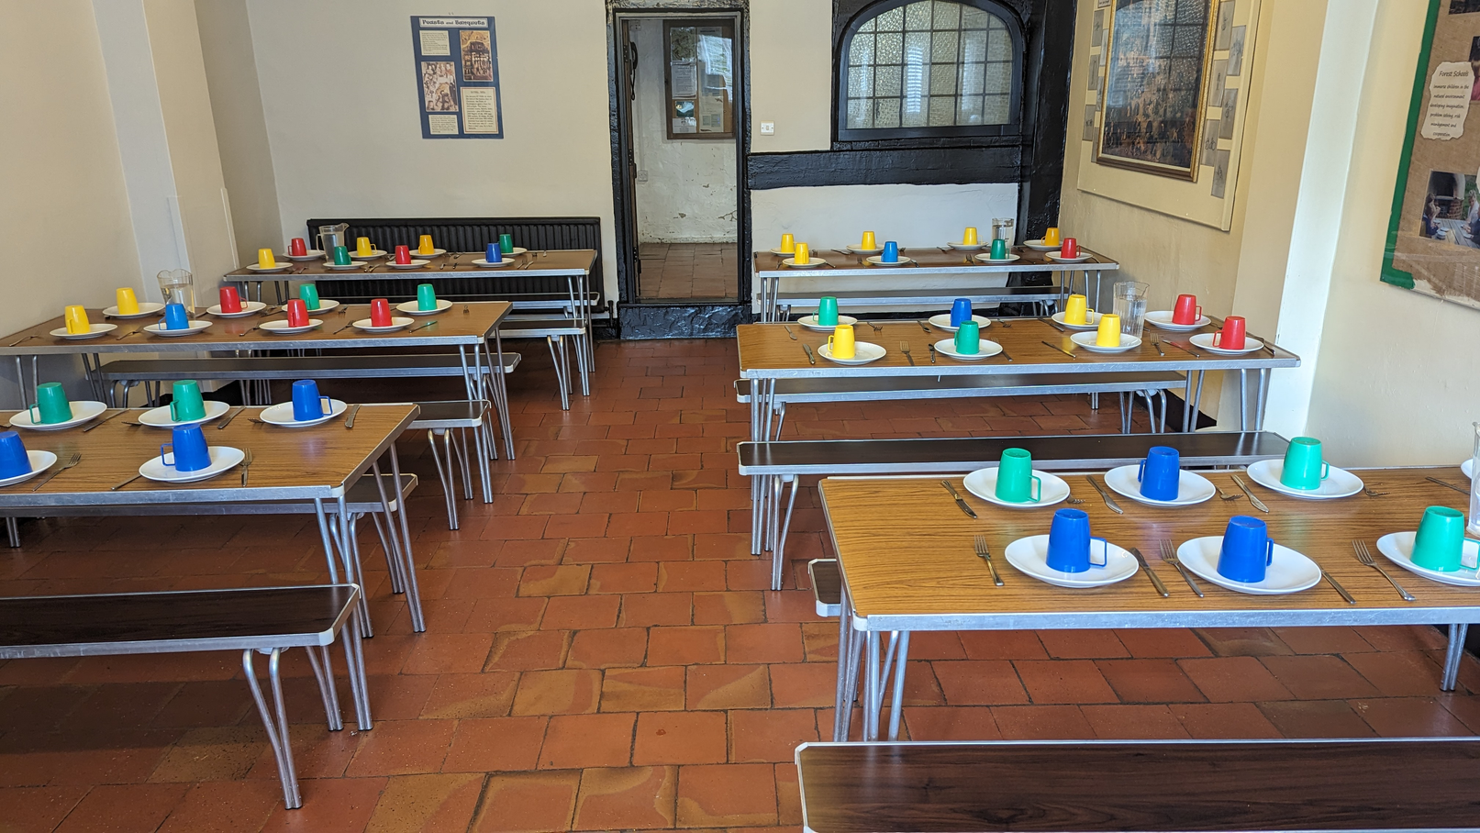

A sample menu
Here are example meals your child may be served. Only one option is served per meal, and this list is for reference only.
Breakfast: Selection of cereal, toast with butter or jam and fresh fruit
Lunch: Veggie burgers; hotdogs; jacket potatoes; chicken fajita wraps. All served with fresh salad.
Dinner: Mild chicken curry with rice and naan bread; pasta bake with garlic bread and roasted vegetables; sausages and potato gratin served with seasonal vegetables
Desserts: Fruit crumble with custard; sticky toffee pudding and cream; chocolate brownies

Slide 22
Residential trip briefing
2

