Slide 1
Year 4 Curriculum Sharing
Mrs Fox and Mrs Hogan
Mrs Marrison and Mrs Casserley

Slide 2
Year 4
Moving into Year 4, we will be focusing on DEVELOPMENT:
Confidence
Interests
Learning Skills
Communication Skills

Slide 3
Literacy
Handwriting taught daily.
Spelling or Guided Reading – every morning. (Please let us know if you are available to help with reading)
Daily Language and Literacy lessons.
‘Big Write’ every other week.
Discrete grammar sessions during Big Write.
Reading practice and comprehension – during Guided Reading sessions and Literacy lessons.
Book bands from last year continue.

Slide 4
Maths
Taught daily.
Children are split into two sets, based on ability.
Each lesson starts with a ‘Five a Day’ challenge, based on arithmetic skills.
‘Big Maths’ every other week, with a continued focus on solving word problems.
KS2 Calculation policy is on the school website.

Slide 5
Maths Made Clear
SCPS has a series of films which aims of to help parents to understand how we teach maths in the school.
Hopefully, this will allow you to help your children to develop their maths skills at home.
Search for ‘Maths Made Clear’ on YouTube or click here for a playlist of our videos.

Slide 6
Topics (history and geography based)
Term 1: Extreme Earth
Term 2: Magnificent Mountains
Term 3: Romans
Term 4: Romans
Term 5: Vikings and Anglo-Saxons
Term 6: Raging Rivers

Slide 7
French, PSHE & RE
French will be taught every Wednesday afternoon.
Formal and ad-hoc PSHE sessions when needed.
Family and relationships, health and wellbeing.
Citizenship and economic wellbeing
Buddhism, Christianity, how people celebrate their faith

Slide 8
PE and Games
PE on Mondays and Wednesday
Gymnastics
Dance
Circuits
Hockey
Netball
Football
Rugby
Basketball
Tennis
Rounders
Cricket
Sports Day

Slide 9
Swimming

Slide 10
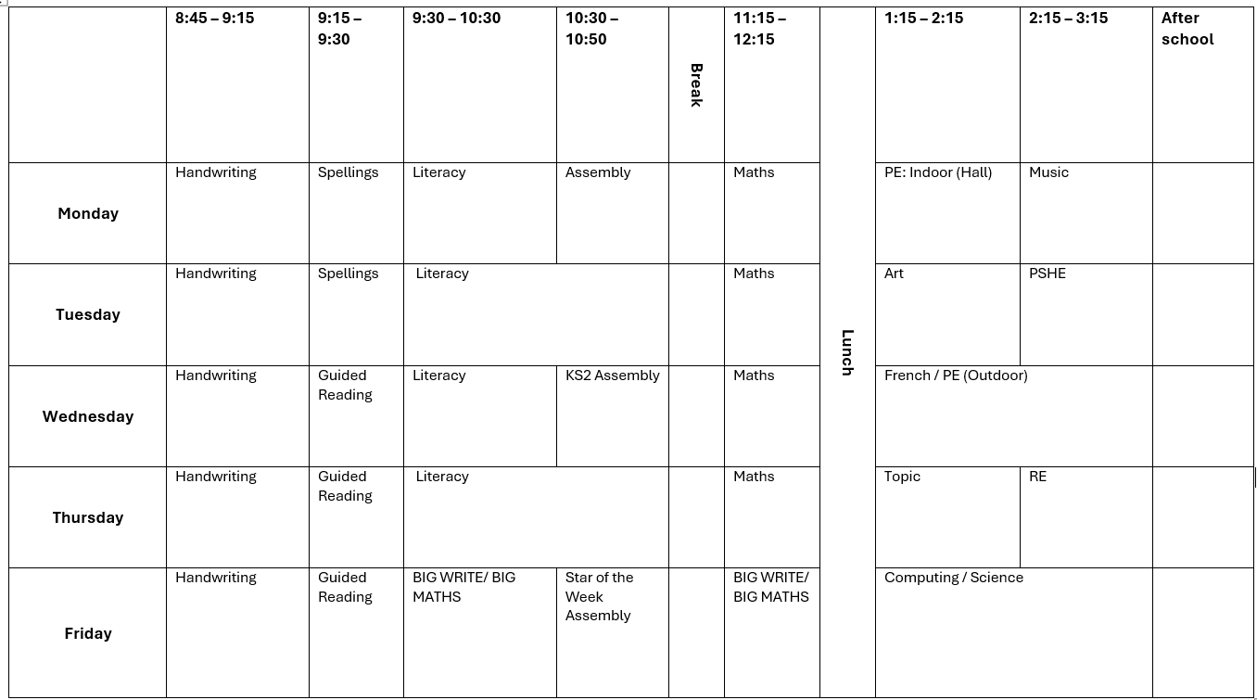
Timetable

Slide 11
Rewards and sanctions
Team points
Star of the week
Value bands – Truth, Politeness, Respect, Kindness and Doing Your Best.
Codes system:
Orange: 10 minutes of break time
Blue: whole of break

Slide 12
Homework
Given out every Thursday and collected in the following Thursday. Starting on Thursday.
Spelling Shed and Times Table Rockstars homework each week – 10 minutes of TTRS and 10 Spelling Shed games. They can do more if they would like!
Each child is expected to read at least four times a week. It should be written up and signed off by parents in their planners.

Slide 13
Library
The library will be open every Tuesday breaktime for children to borrow books.
The bookshop is open every Wednesday breaktime, where children can buy books and stationery.
If you have overdue books, don’t worry! If your child brings their books back on a Tuesday, they won’t be charged.

Slide 14
Trips and visits
Ufton Court Residential 17th-19th June. Information and Payment Details to be sent out shortly.
Roman Britain Day with History off the Page. Thursday 8th January.

Slide 15
Playtime
In Key Stage 2, there is no official playtime in the afternoon. However, we are aware that sometimes the children will need a break!
Children are no longer provided snacks by the school, so they must be brought in.
Snacks must be healthy – fruit and veg only.

Slide 16
Parent consultations
Exact dates are to be confirmed.
The first is usually on Tuesday and Thursday after school on the last week of November.

Slide 17
Forest Camp

Slide 18
End of the day
Please collect your children from the playground at the end of the day. We will be available at that time if you need to talk to us.
Alternatively, contact us by emailing the office.

Slide 19
Thank you!
Any questions?

